Slide 1

Getting Started With Statistics
PsychoStat

Slide 2

Population vs Sample: Overview
Population | Sample
Definition: Every member, item, or subject in the group that is ultimately of interest | Definition: The subset of members, items, or subjects from the population that we actually have data on
Example #1: We are interested in studying the sleep habits of all 30 million college students in the U.S. Our goal is to learn more about the sleep habits of all U.S. college students | Example #1: We actually have data from 10,000 college students in the U.S. who respond to a survey We only are able to collect data from a subset of all college students, and this subset is our sample
Example #2: We are interested in studying the relationship between food intake and calories burned for a specific species of field mouse Our goal is to learn more about the relationship between food intake and calories burned for all of the field mice of this species | Example #2: We actually have data from an experiment we ran on 230 field mice in our lab We are only able to collect data from a subset of all field mice of this species, and this subset is our sample

Slide 3
Population Parameters vs Sample Statistics
Population Parameters | Sample Statistics
Parameters: A quantity or characteristic used to describe the entire group of interest (the population) | Definition: A quantity or characteristic used to describe the subset we have data for (the sample)
Example: The correlation between food intake and calories burned for at the population-level (for all field mice of that species in this case) | Example: The correlation between food intake and calories burned observed for our sample of field mice
Our goal is to learn about the characteristics of our population, which are quantified as parameters. However, we usually only have access to sample data. We can quantify the characteristics of our sample using statistics, and then use these statistics as our best guesses/estimates regarding the population parameters. | Example #2: We actually have data from an experiment we ran on 230 field mice in our lab We are only able to collect data from a subset of all field mice of this species, and this subset is our sample

Slide 4
Descriptive vs Inferential Statistics
Descriptive Statistics | Inferential Statistics
Definition: The use of sample statistics to describe the sample dataset No mention of population characteristics yet, we’re just describing the sample data itself | Definition: The use of sample statistics to draw inferences about the population parameters Extrapolate from actual sample data to draw conclusions about population parameters
Bar charts Histograms Scatterplots Summary statistics | Hypothesis tests and Confidence Intervals What’s the likelihood of observing our sample statistic if the sample data was really drawn from a certain population/parameter value?
Example: Let’s say we are interested in studying the average number of hours of sleep per night for all 30 million college students in the U.S., and we give a survey to 10,000 college students in the US. We hypothesize that students, on average, get 9 hours of sleep (population average) The average number of hours of sleep for our sample is 7 hours per night (sample average) How likely is it that our population hypothesis is correct, given our sample data? | Example #2: We actually have data from an experiment we ran on 230 field mice in our lab We are only able to collect data from a subset of all field mice of this species, and this subset is our sample

Slide 5
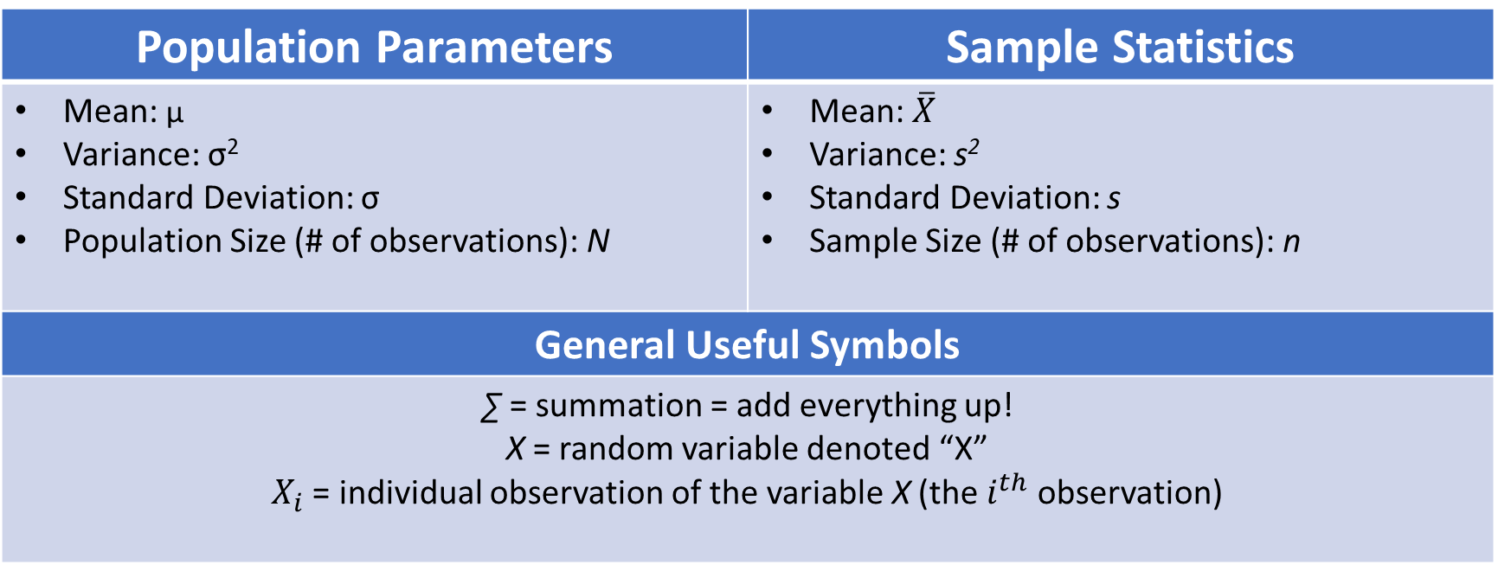
Population vs Sample: Symbols
Population Parameters | Sample Statistics
Mean: µ Variance: σ² Standard Deviation: σ Population Size (# of observations): N | Mean: $\overline{X}$ Variance: s² Standard Deviation: s Sample Size (# of observations): n
General Useful Symbols | We typically can only calculate measures and characteristics for our sample through statistics
∑ = summation = add everything up! X = random variable denoted “X” $X_{i}$ = individual observation of the variable X (the $i^{th}$ observation) | Example #2: We actually have data from an experiment we ran on 230 field mice in our lab We are only able to collect data from a subset of all field mice of this species, and this subset is our sample

Slide 6
Recap
In statistics, our goal is usually to quantify some characteristic regarding a group of interest.
We very rarely have access to the data from every single member of that group of interest.
Instead, we collect data from a smaller sample of observations from that group of interest.
Use descriptive statistics to describe our sample data
Use inferential statistics to make inferences about the characteristics of the population that we’re ultimately interested in.
How do we use sample statistics to draw conclusions about the population?
Sampling distributions!

